Slide 1


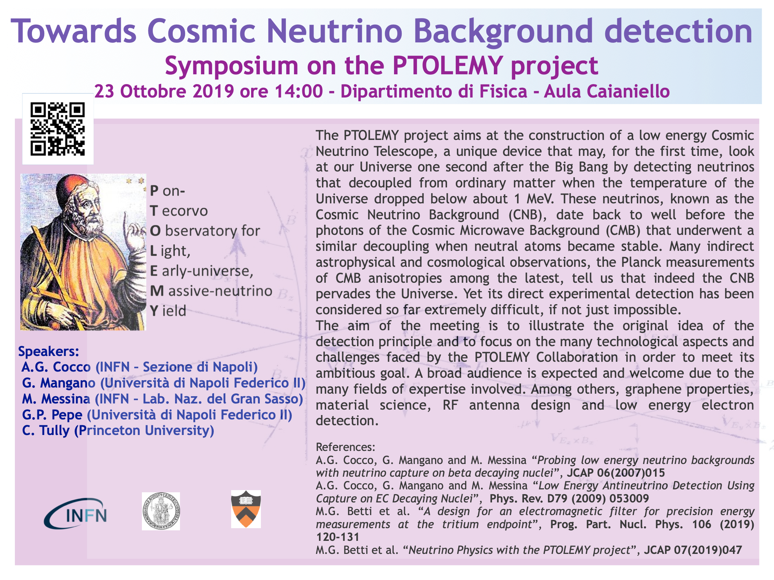
Past and future
of the
Cosmological Relic Neutrino Detection
Università
degli Studi di Napoli
Dipartimento di Fisica
E. Pancini
INFN-Na
Dr. Marcello Messina, INFN-LNGS

Slide 2
Outlines
Short introduction to the features of Relic Neutrino
Methods proposed so far for the Cosmological Relic Neutrinos detection
A new process to detect Cosmological Relic Neutrinos
Details about cross section calculations
Effects enhancing interaction rate
PTOLEMY experimental approach
Summary

Slide 3
Cosmic recipe
Material | Particles | <E> or m | N | <ρ>/ρ_{C}
Radiation | γ | 0.1 meV | 10⁸⁷ | 0.01%
Hot Dark Matter | Neutrinos | >0.04 eV <0.6 eV | 10⁸⁷ | >0.1% <2%
Ordinary Matter | p,n,e | MeV-GeV | 10⁷⁸ | 5%
Cold Dark Matter | WIMPs? Axions? | >100GeV <meV | <10⁷⁷ >10⁹¹ | 25%
Dark Energy | ? | 10⁻³³ meV | ? | 70%

Slide 4
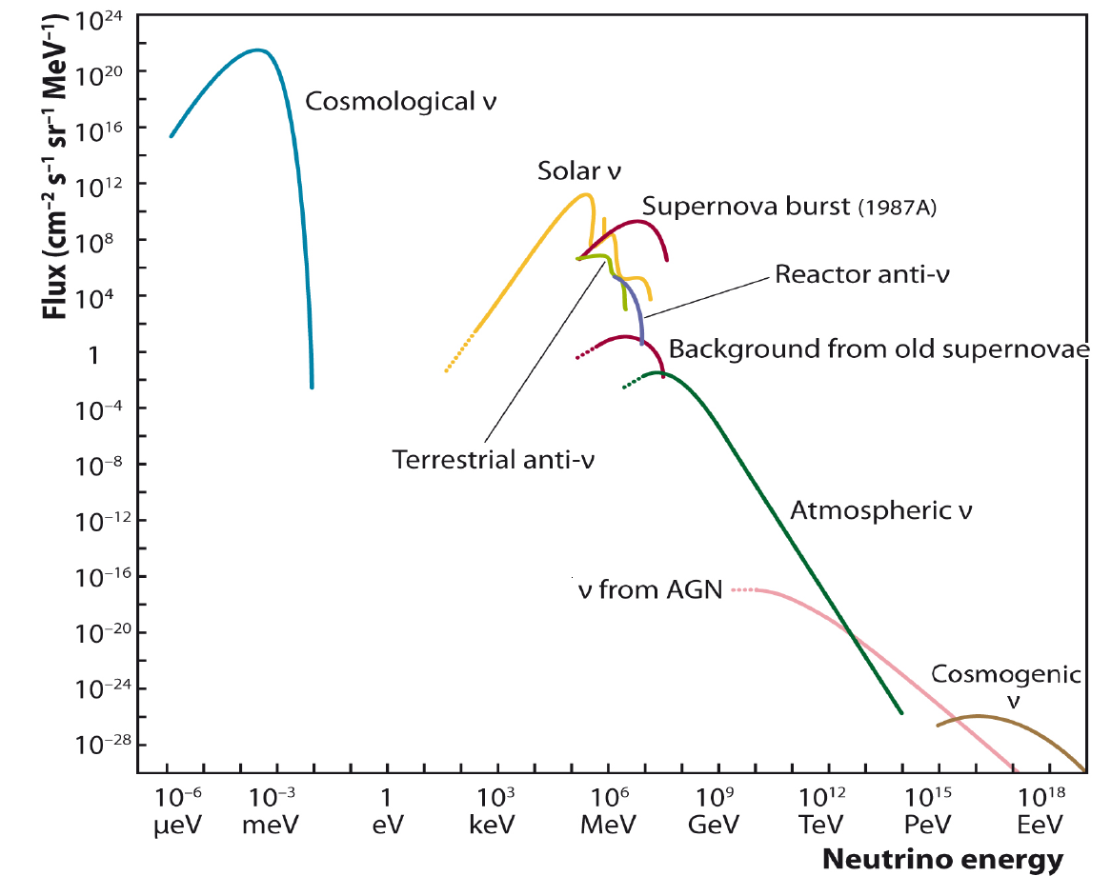
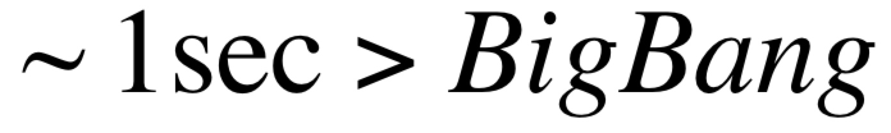
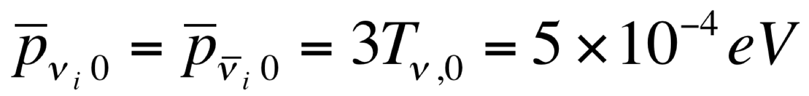
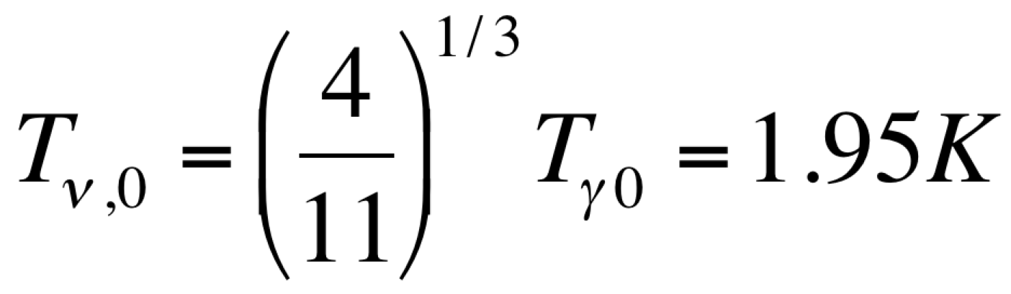
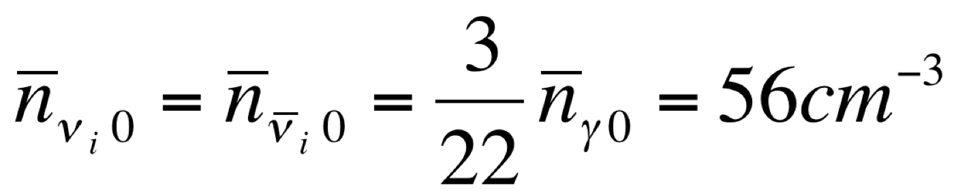
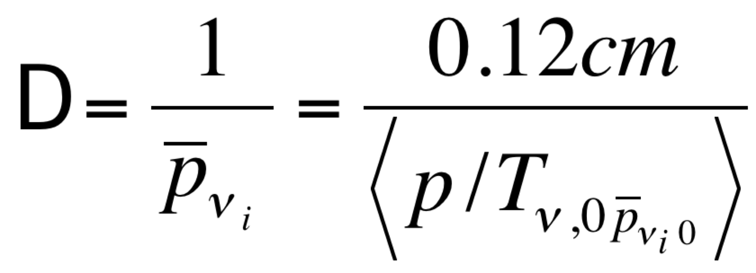
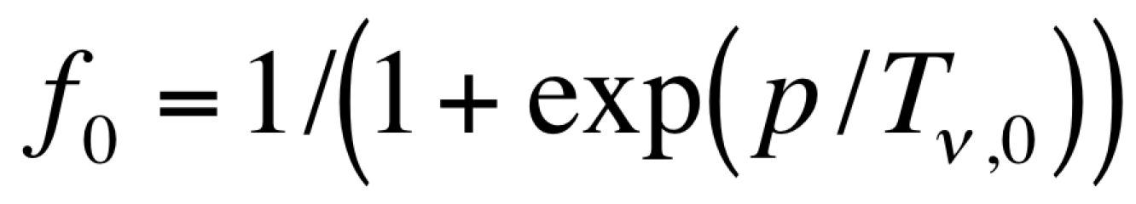
Cosmological Relic Neutrinos
What we know about Cosmological Neutrino Background (CNB)
Date of birth
density per flavor
Highest flow among known
Components of the Universe
temperature
mean kinetic energy
Wave function
extension
p distribution without
late-time small scale
clustering
and μ/ T_{ν}<0.1

Slide 5
The detection methods proposed so far

Slide 6
The longstanding question (I)
Is it possible to measure the CRN? Method 1
The first method proposed for the detection of CRN was based on the fact that given the null mass of the neutrinos (today we know it is small) any variation of ν momentum (Δp) implies
a variation of the ν spin (ΔJ) (R.R. Lewis Phy. Rev. D21 663, 1980):

Slide 7
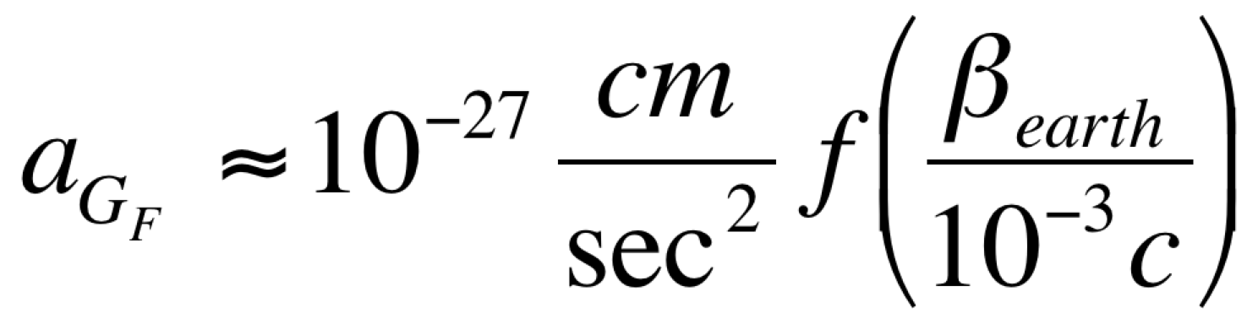
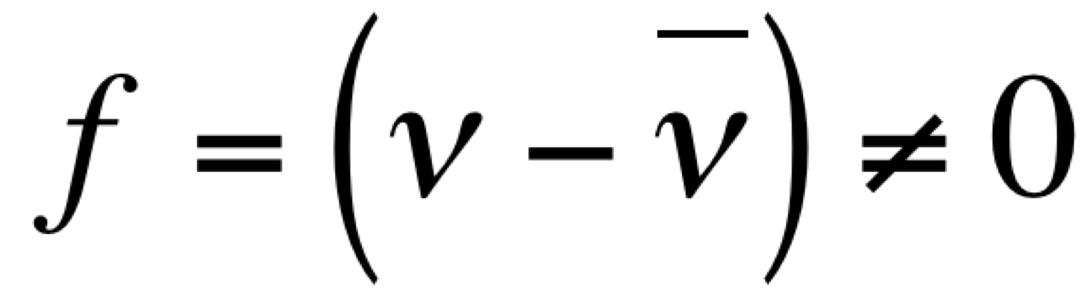
The longstanding question (II)
Is it possible to measure the CRN?
Method 1
Unfortunately what assumed by Lewis was shown by Cabibbo and Maiani (Phys. Lett. B114 115,1982) to vanish at first order in Fermi constant G_{F}.
But there is still an effect (Stodolsky Phys. Rev. Lett. 34, 110 ) at first order in G_{F} where a polarized target experiences a force due to the scattering with polarized neutrinos (only a tiny part of the CRN flux). The effect can only be seen if :
Since the n wave length is ~ mm (λ) can be envisaged an enhancement of the interaction rate due to coherent sum of the invariant scattering amplitudes in a volume λ³. Under this assumption:
Laser resonator
Persistent magnet
Suspension magnet
A
B
v
Balancing mass
The value of acceleration expected is almost 15 order of magnitude far from the current sensitivity of any accelerometers used today a “Cavendish” experiment.
v
v
v
v
v
v
v
v
v

Slide 8
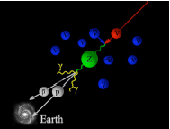
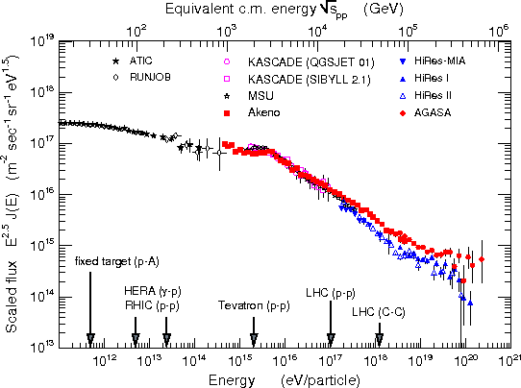
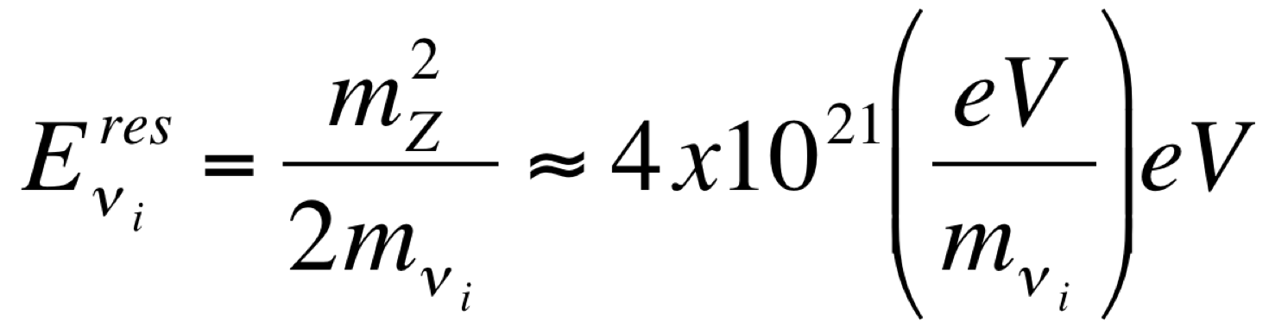
The longstanding question
Is it possible to measure the CRN ?
Method 2
The second method propose a resonant annihilation of EECν off CRN into Z-boson that occurs at energy:
The signature would be a deep in the neutrino flux around 10²² eV or an events excess of photons or protons beyond the GKZ deep (where the photons of CMB are absorbed by protons to produce pions).

Slide 9
The longstanding question
Is it possible to measure the CRN ?
Method 3
The third method propose the observation of interactions of extremely high energy protons from terrestrial accelerator beams with the relic neutrinos.
Accelerator
Earth
In this case even with an accelerator ring (VLHC) of ~4x10⁴ km length (Earth circumference) with E_{beam}~10⁷ TeV the interaction rate would still be negligible.

Slide 10
Summarizing
Is it possible to measure the CNB ?
All methods proposed so far require unrealistic experimental apparatus
or astronomical neutrino sources not yet observed and not even hypothesized .
For reviews on this subject see:
A.Ringwald “Neutrino Telescopes” 2005 – hep-ph/0505024
G.Gelmini G. B. Gemini Phys.Scripta T121:131-136,2005

Slide 11
A new idea to detect
Cosmological Neutrino Background
We need a process where ν can contribute only via its quantum numbers and no additional energy is required!

Slide 12
Detection principle
Massive neutrino and neutrino capture on beta decaying nuclei
W. Weinberg, Phys. Rev. 128 1962
A.G.Cocco, G.Mangano and M.Messina JCAP 06(2007) 015
e±
β decay
(−)
ν_{e}
(A, Z)
(A, Z ± 1)
Neutrino Capture on a
Beta Decaying Nucleus
(NCB)
e±
(−)
ν_{e}
(A, Z)
(A, Z ± 1)
This process has no energy threshold !

Slide 13
NCB signature
Neutrino masses of the order of 1 eV are compatible with the present picture of our Universe.
NCB
m_{ν}= 0
Events/bin
Beta decay
m_{ν}≠ 0
Q_{β}
m_{ν}
T_{e}
2m_{ν}
The events induced by Neutrino Capture have a unique signature: there is a gap of 2m_{ν} between the NCB electron energy and the energy of beta decay electrons at the endpoint.

Slide 14
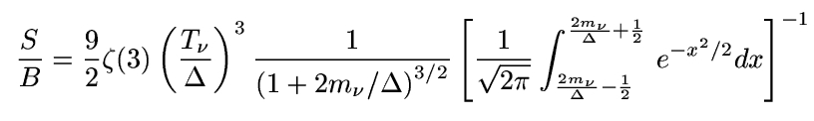
Signal to background ratio
dn/dT_{e}
β
Δ
Δ
Δ
Δ
Observing the last energy bins of width Δ
m_{ν}
T_{e}
2m_{ν}
where the last term is the probability for a beta decay electron
at the endpoint to be measured beyond the 2m_{ν} gap
It works for Δ<m_{v}

Slide 15
Some relevant facts
Our proposal is based on the fact that the σv does not vanishes when the ν energy is negligible and it reaches a constant value depending on the target nucleus.
Other authors adopted different ν cross section calculations:
σ≈m² for not relativistic neutrinos (m_{ν}~1eV) and σ=σ₀ xE² (m_{ν}~meV) for relativistic neutrinos and subsequently they obtained cross section in the range of σ≈ 10⁻⁵⁶ -10⁻⁶² cm².
G. B. Gemini Phys.Scripta T121:131-136, 2005 and references therein.

Slide 16
How to evaluate NCB cross section
N’
N
e⁻
-
ν
ν
N’
N
e⁻
ν
The invariant amplitudes of the two processes are identical (due to ν crossing).
This fact allows to evaluate the NCB cross section in an easy way.

Slide 17



NCB Cross Section (I)
NCB
Where
the Fermi function and
he nuclear shape factor
which is an angular momentum weighted average of nuclear state transition
amplitudes.
It is more convenient to focalize our attention on the interaction rate:

Slide 18


NCB Cross Section (II)
The most difficult part of the rate estimation is the nuclear shape factor
calculation:
Where λ_{ke} , μ_{ke} and γ_{ke} are the Coulomb coefficients, k_{e} and k_{ν} are the electron and neutrino radial wave function indexes (k=j+1/2), K=L-1 represents the nuclear transition multipolarity
(|k_{e}- k_{ν} |≤K≤|k_{e}+ k_{ν} |) and, M² and m² are nuclear matrix elements. Their calculation is the main source of uncertainty for σ_{NCB}.
On the other hand, the NCB (see previous slide) and the corresponding beta decay rates are strongly related thanks to the following formula:

Slide 19
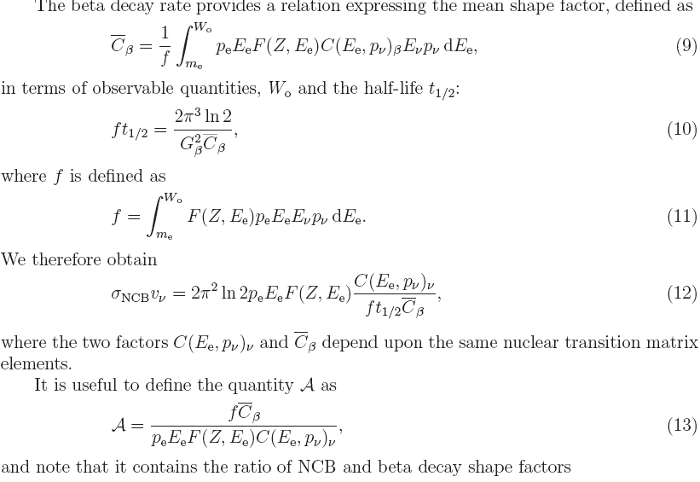

NCB Cross Section (III)
The beta decay rate provides a relation that allows to express the mean shape
factor:
in terms of observable quantities:
then if we derive G_{β} in terms of C_{β} and of ft_{1/2} and replace it in the expression of the NCB cross section we obtain:
So the σ_{NCB} can be calculated in terms of well measured quantities, of C(E_{e},p_{ν})_{ν} and C_{β} which depend on the same nuclear transition matrix elements.

Slide 20
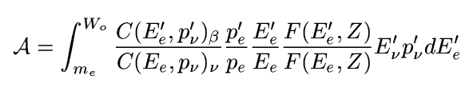

NCB Cross Section (IV) a new parameterization
It is convenient to introduce
where A depends only by E_{ν} . Then if we introduce A in the cross section expression we have:
Thus σ_{NCB} can be easily calculated in terms of the decay half-life of the corresponding beta decay process and of the quantity A where the neutrino energy dependency is hidden. The function A has the fundamental feature of showing only the ratio of the nuclear shape factors where the theoretical uncertainties vanish.

Slide 21


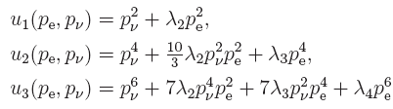

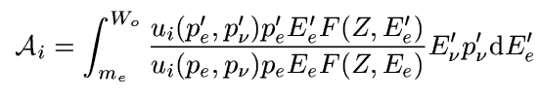
NCB Cross Section (V) on different types of decaying nuclei
Super-allowed transitions:
0⁺->0⁺
This expression of the cross section is a very good approximation also for allowed
transitions (Tritium case) since:
J->J
• K-th unique forbidden
J->J+K
(Leptonic contribution)
(Nuclear contribution)

Slide 22
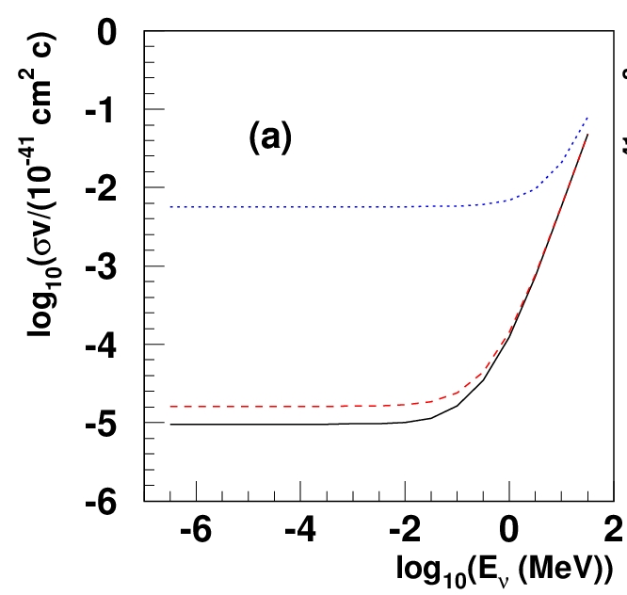
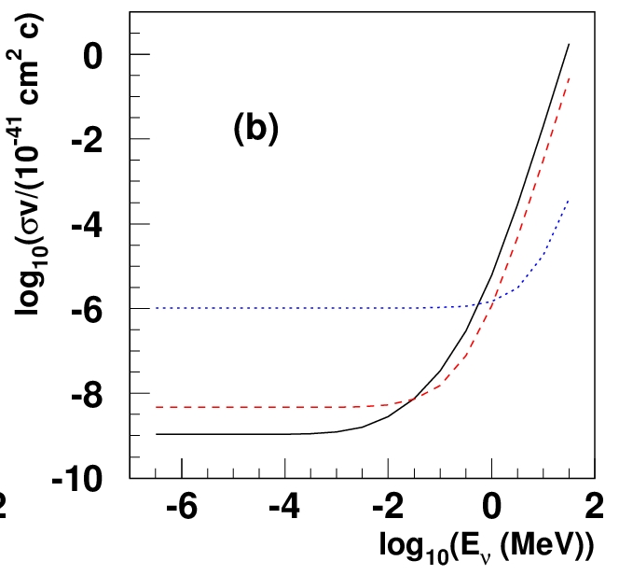
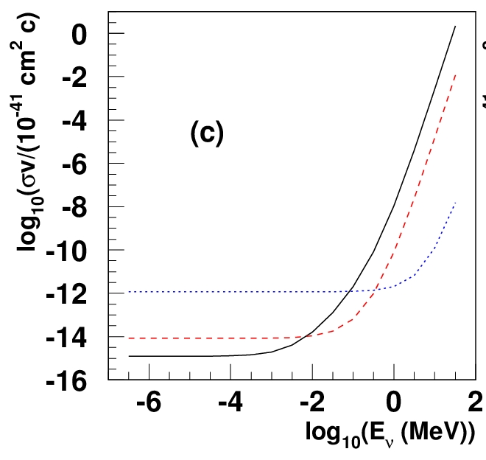
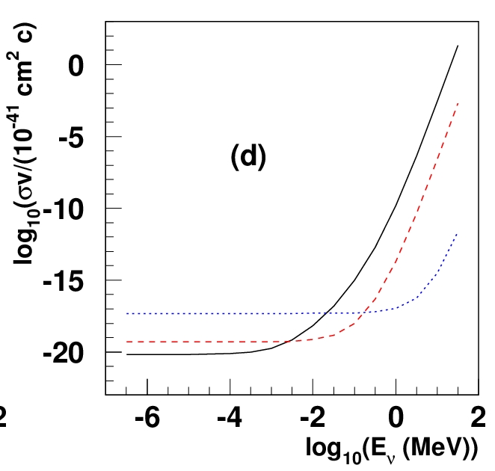
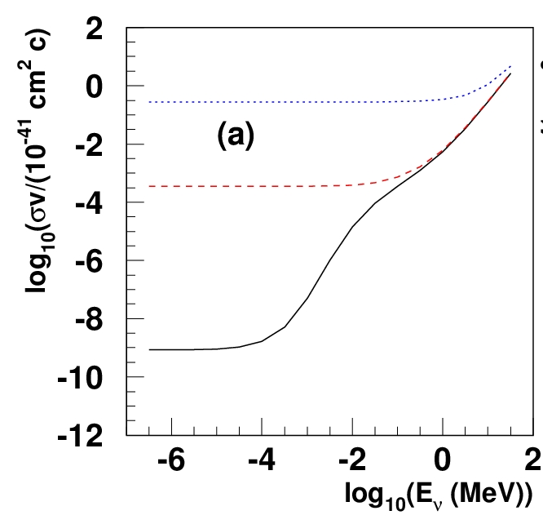
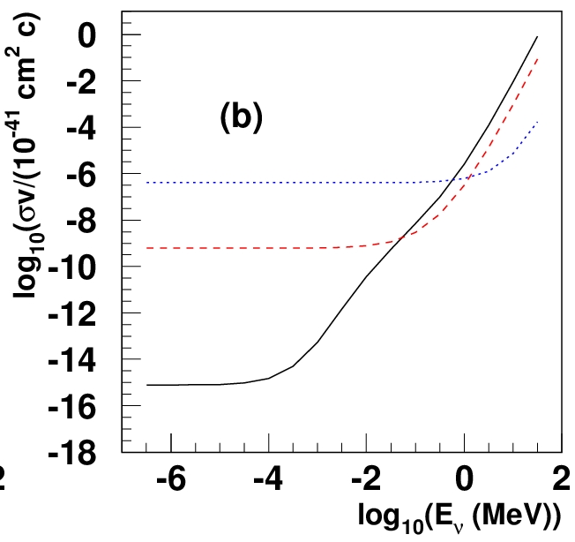
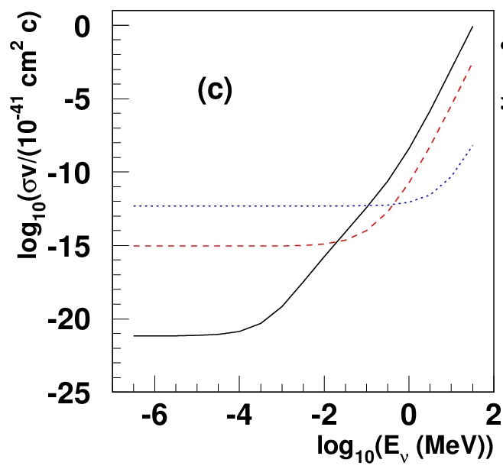
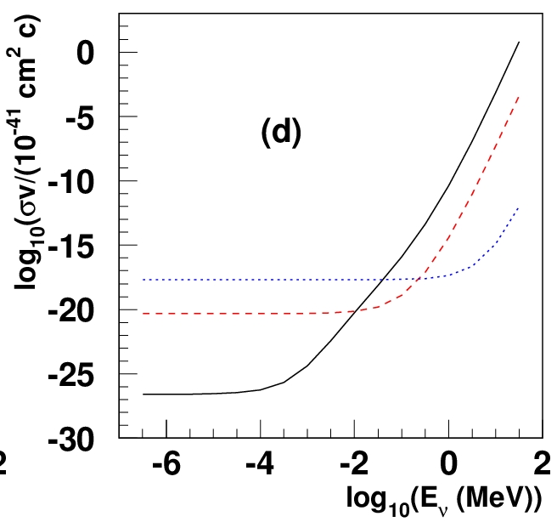
NCB Cross Section as a function of E_{ν}, Q_{β} for different nuclear spin transitions
allowed
1st unique forbidden
2nd unique forbidden
3rd unique forbidden
β⁻ (top)
Q_{β} = 1 keV
Q_{β} = 100 keV
Q_{β} = 10 MeV
β⁺ (bottom)
allowed
1st unique forbidden
2nd unique forbidden
3rd unique forbidden

Slide 23
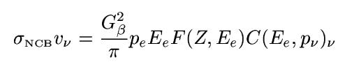


NCB Cross Section Evaluation
The case of Tritium
Using the expression
we obtain
where the uncertainty is due to Fermi and Gamow-Teller matrix
element uncertainties
Using shape factors ratio
where the uncertainty is due only to uncertainties on Q_{β} and t_{1/2}

Slide 24
NCB Cross Section results achieved so far
Exist a process (NCB) that allows in principle the detection of neutrino of vanishing energy!
The cross section (times the neutrino velocity) does not vanish when the neutrino energy becomes negligible!
We described a method to calculate any NCB cross section by means of measured known quantities (t_{1/2}) and the ratio of the nuclear shape factors. Reduced theoretical uncertainties!

Slide 25
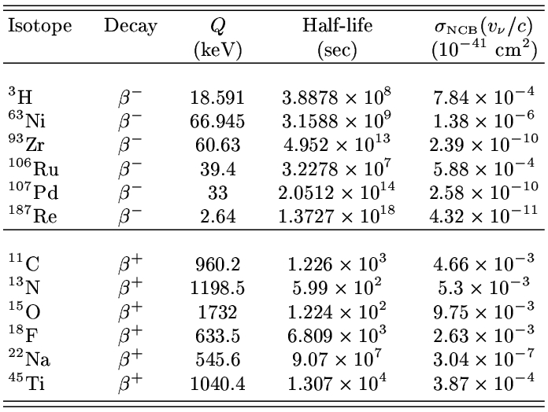
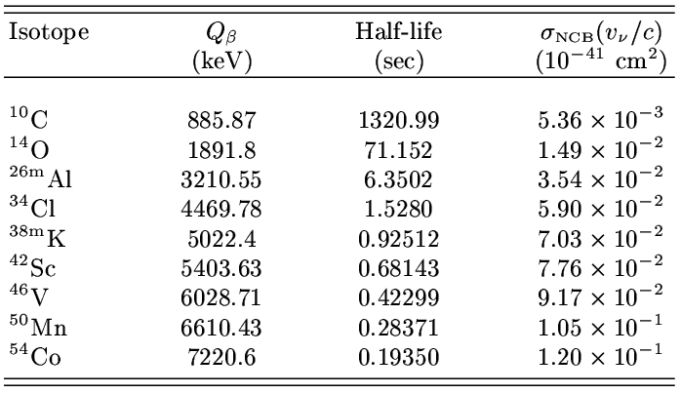
NCB Cross Section Evaluation specific cases
Super-allowed 0⁺ 0⁺
Nuclei having the highest product σ_{NCB} t_{1/2}

Slide 26
Relic Neutrino Detection
“discovery potential”
As an example, given a neutrino mass of 0.7 eV and an energy resolution at the beta decay endpoint of 0.2 eV a signal to background ratio of 3 is obtained. In the case of 100 g mass target of Tritium it would take one year and half to observe a 5σ effect.

Slide 27
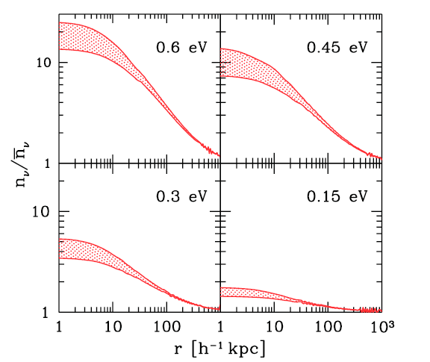
Possible effects enhancing the NCB
A.Ringwald and Y.Y.Wong (JCAP12(2004)005) made predictions about the CRN density by using an N-body simulation under two main assumptions. In one they considered the clustering of the CRN under the gravitational potential given by the Milk Way matter density as it is today. The second prediction was made considering a gravitational potential evolving during the Universe expansion (Navarro, Franck White). In both cases the neutrinos were considered as spectators and not participating to the potential generation.
(53/cm³ ⁾
MW now
NFW
Neutrino density increase

Slide 28
Statistical significance with increased density
In the table the target masses are shown for different neutrino clustering models to have
a 5 sigma evidence of NCB (on Tritium target) in one year.
m_{ν}(eV) | mass/year (FD) | mass/year (NFW) | mass/year (MW)
0.6 | 100 g | 8 g | 5 g
0.3 | 100 g | 33 g | 25 g
0.15 | 100 g | 75 g | 62 g

Slide 29
Two issues:
Rate
Background

Slide 30
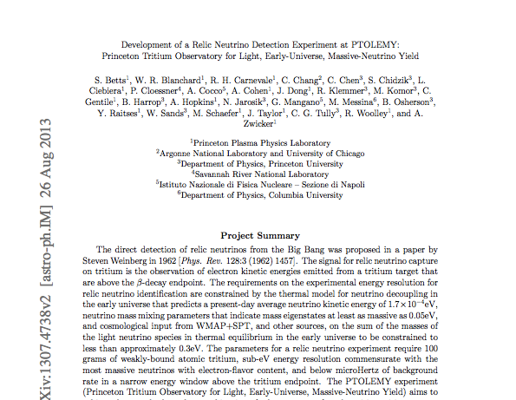
PTOLEMY project started thanks to the effort of C. Tully at the Princeton University

Slide 31
To Conclude
The discussion on Relic Neutrino Detection restarted
after long time that it was believed to be dead.

